Slide 1

Performance Efficient Scheduling in Dynamic Cores
End-Semester Presentation
Presented by:
Hatim Shakir (B200830CS),
Arif Raza Mansuri (B200808CS), Anagha M V (B200762CS)
Guided & Supervised by:
Dr. Nirmal Kumar Boran,
Department of Computer Science & Engineering

Slide 2
01 : Background

Slide 3
Background
Venkat et. al have shown significant improvements by incorporating heterogeneous ISAs to exploit the inherent heterogeneity in programs.
The program affinity changes all throughout, and if successfully exploited can result in significant performance and energy savings.
A heterogeneous multi-ISAs outperforms the optimal heterogeneous single-ISA design by 20.8%
Improves energy efficiency over the most efficient single-ISA design by 23%
References:
Venkat, A. and Tullsen, D.M., 2014. Harnessing ISA diversity: Design of a heterogeneous-ISA chip multiprocessor. ACM SIGARCH Computer Architecture News, 42(3), pp.121-132.

Slide 4
Background
Boran et. al have shown importance of a simple and effective scheduling algorithm to improve performance.
Performance of any ISA can be modelled very effectively with only a handful of parameters – they used 14!
When modelled properly, a simple linear regression model beats complex NN models such as GRNN.
Regression-based scheduler shows 29.6% increase in mean performance when compared to the x86 baseline.
References:
Boran, N.K., Yadav, D.K. and Iyer, R., 2019. Performance modelling and dynamic scheduling on heterogeneous-ISA multi-core architectures. In VLSI Design and Test: 23rd International Symposium, VDAT 2019, Indore, India, July 4–6, 2019, Revised Selected Papers 23 (pp. 702-715). Springer Singapore.

Slide 5
Background
Boran et. al have shown promising results with a finer-grain scheduling, at the functional level.
Functions could have varying affinity based-on different inputs, control paths taken during execution and dynamic instruction count.
The proposed approach achieves up to 22.9 percent speedup using oracle based scheduling mechanism.
They proposed a heuristics technique which achieves a speedup of only 8.4 percent
References:
Boran, N.K., Rathore, S., Udeshi, M. and Singh, V., 2020. Fine-Grained Scheduling in Heterogeneous-ISA Architectures. IEEE Computer Architecture Letters, 20(1), pp.9-12.

Slide 6
02 : Problem Statement

Slide 7
Problem Statement
Bridging the gap between 8% (heuristics) and 23% (oracle) for function scheduling in dynamic core Heterogeneous ISAs.
References:

Slide 8
03: Proposal

Slide 9
Proposal
The use of machine learning algorithms and models to correctly predict the affined ISA
Reducing the hardware overhead required for prediction-based scheduler.
References:

Slide 10
Proposal
Choosing useful parameters from below mentioned parameters for affinity prediction:
Number of Cycles
Number of Instructions
Number of Branch Mispredictions
Number of Integer & Floating point Instructions
Number of Load & Store Instructions
I-Cache Misses
D-Cache Misses
L2-Cache Misses
IQ-Full, LSQ-Full events
ROB Full Events

Slide 11
04 : Observations

Slide 12
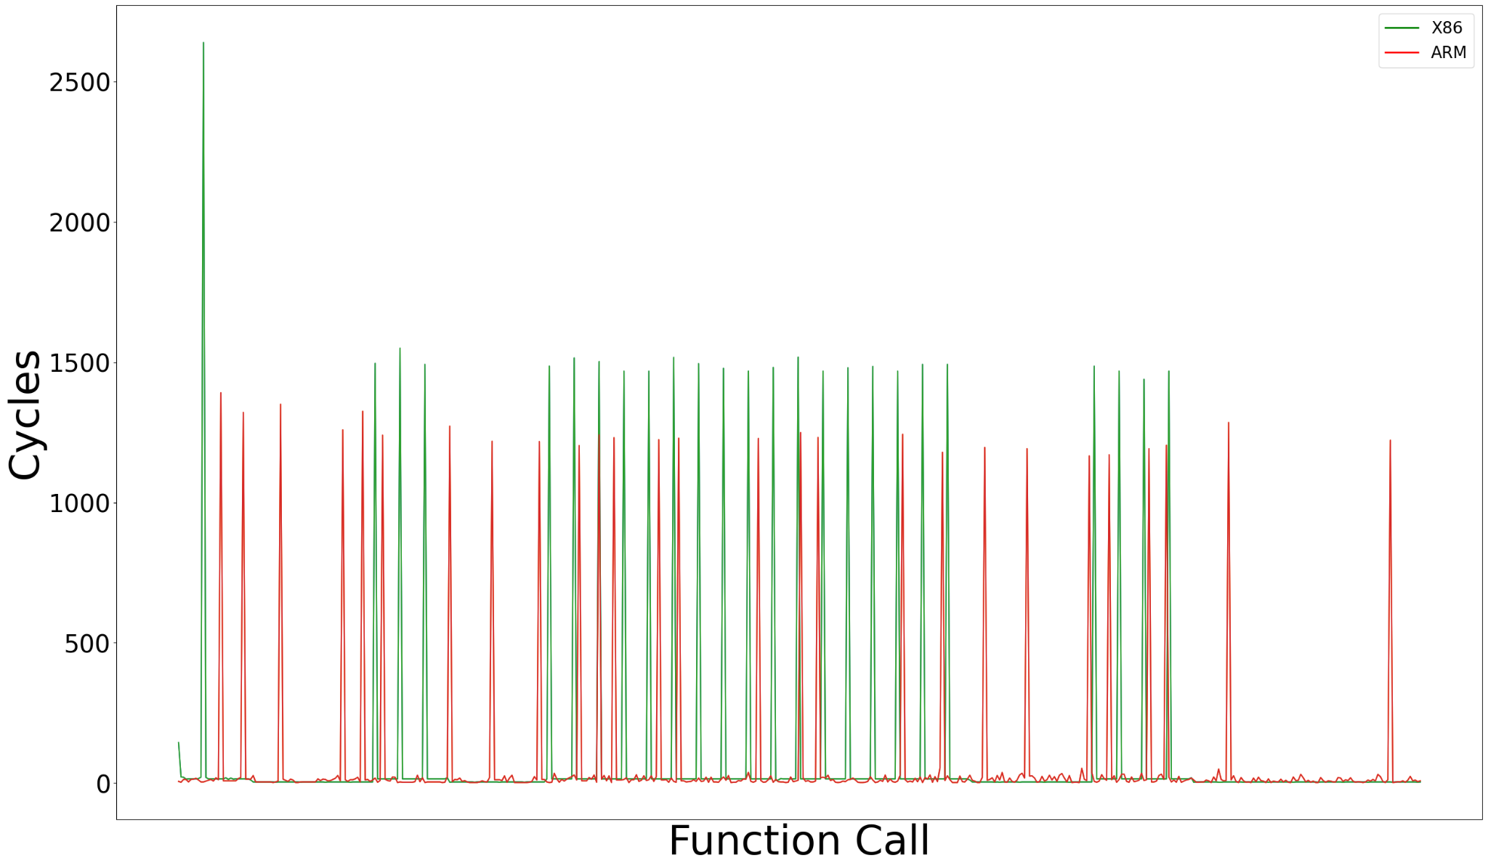
Observations – spec_rand
References:
N. Binkert et al., “The Gem5 simulator,” SIGARCH Comput. Archit. News,vol. 39, pp. 1–7, Aug. 2011.

Slide 13
Observations – spec_rand
Different ISAs may have different number of cycles for the same functional execution
Same ISAs may have different number of cycles for the same function
The spikes in number of cycles might be at different execution times.
References:
N. Binkert et al., “The Gem5 simulator,” SIGARCH Comput. Archit. News,vol. 39, pp. 1–7, Aug. 2011.

Slide 14
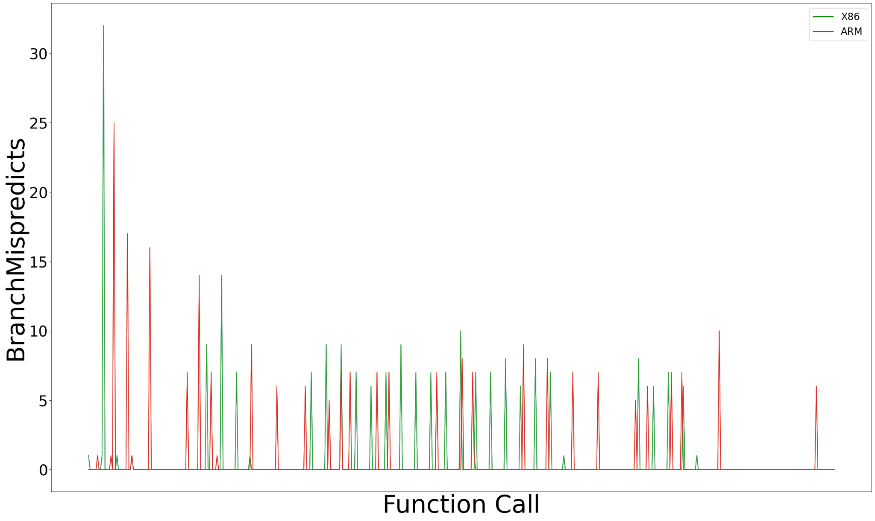
Observations – spec_rand
References:
N. Binkert et al., “The Gem5 simulator,” SIGARCH Comput. Archit. News,vol. 39, pp. 1–7, Aug. 2011.

Slide 15
Observations – spec_rand
References:
N. Binkert et al., “The Gem5 simulator,” SIGARCH Comput. Archit. News,vol. 39, pp. 1–7, Aug. 2011.

Slide 16
Observations – spec_rand
References:
N. Binkert et al., “The Gem5 simulator,” SIGARCH Comput. Archit. News,vol. 39, pp. 1–7, Aug. 2011.

Slide 17
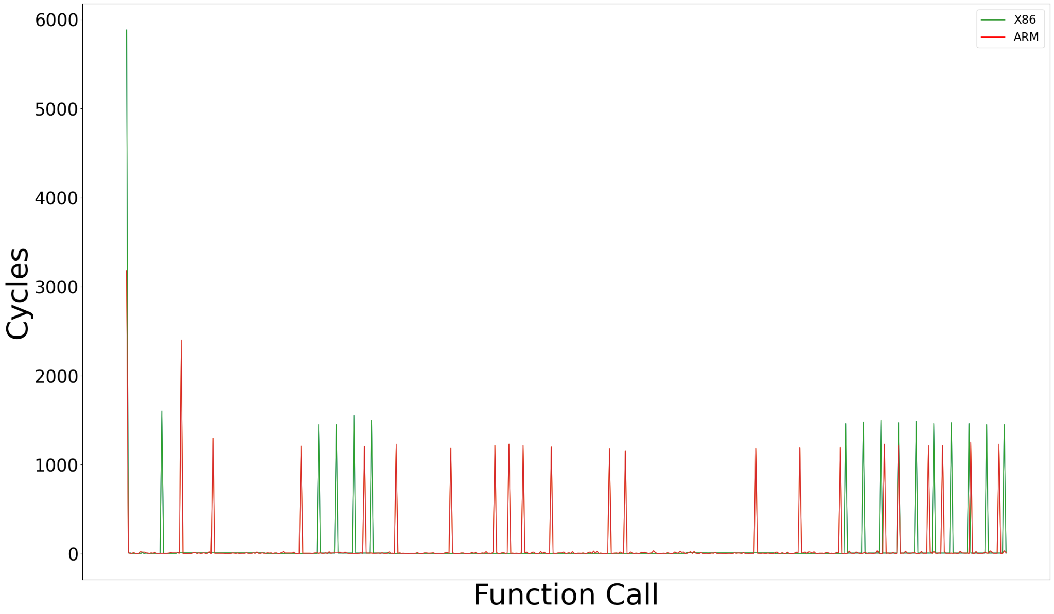
Observations – spec_genrand_int32
References:
N. Binkert et al., “The Gem5 simulator,” SIGARCH Comput. Archit. News,vol. 39, pp. 1–7, Aug. 2011.

Slide 18
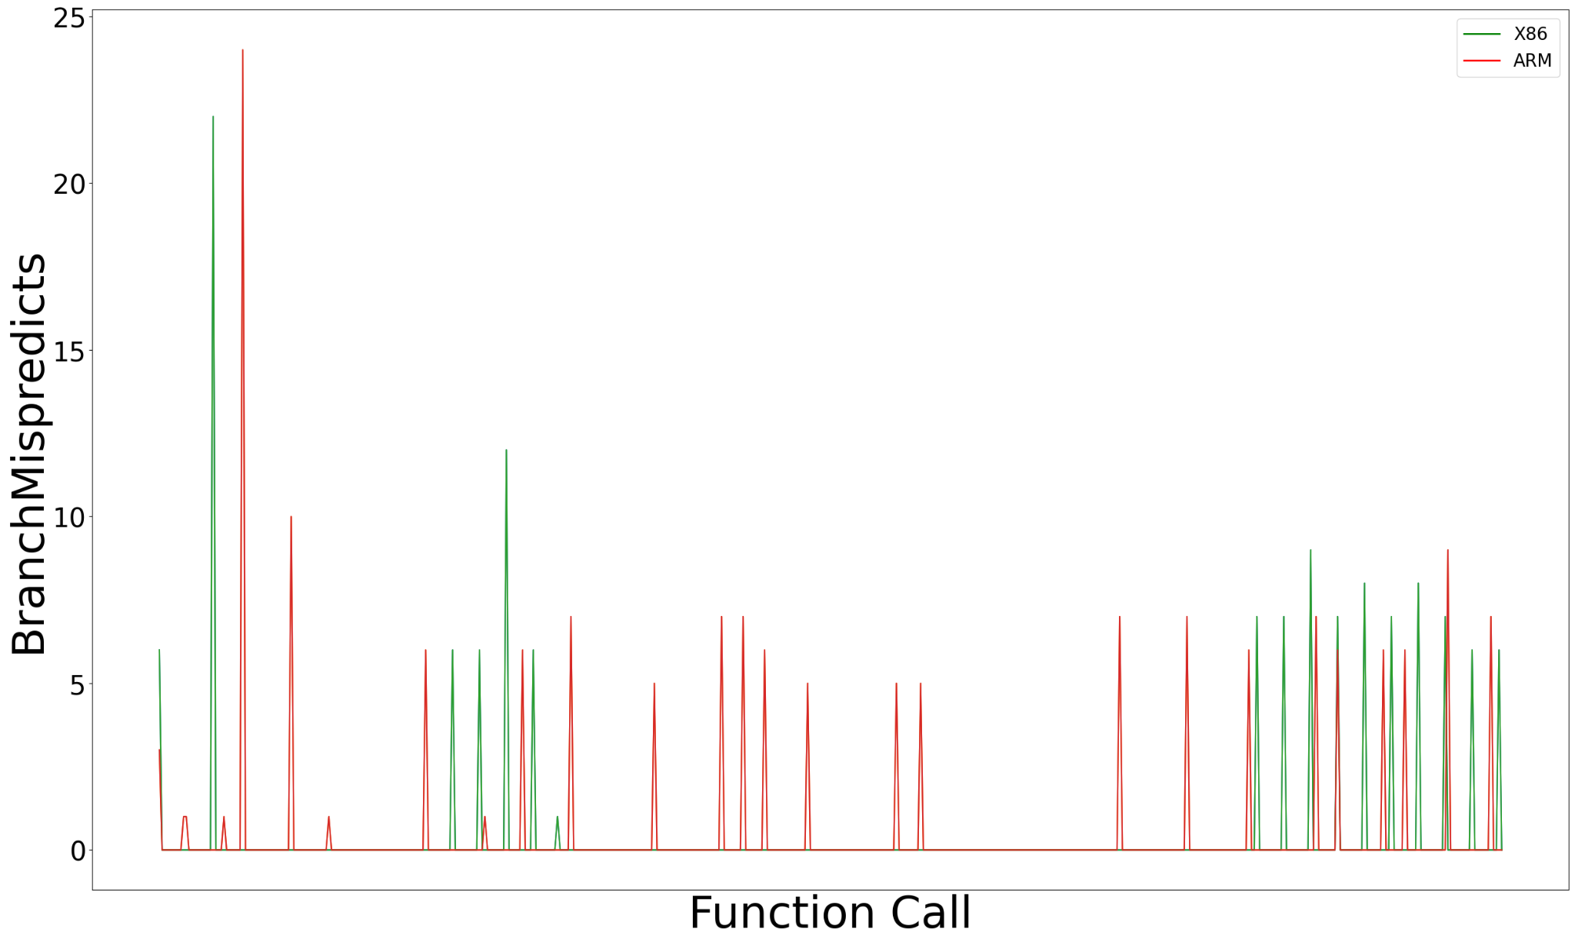
Observations – spec_genrand_int32
References:
N. Binkert et al., “The Gem5 simulator,” SIGARCH Comput. Archit. News,vol. 39, pp. 1–7, Aug. 2011.

Slide 19
Observations – spec_genrand_int32
References:
N. Binkert et al., “The Gem5 simulator,” SIGARCH Comput. Archit. News,vol. 39, pp. 1–7, Aug. 2011.

Slide 20
Observations – spec_genrand_int32
References:
N. Binkert et al., “The Gem5 simulator,” SIGARCH Comput. Archit. News,vol. 39, pp. 1–7, Aug. 2011.

Slide 21
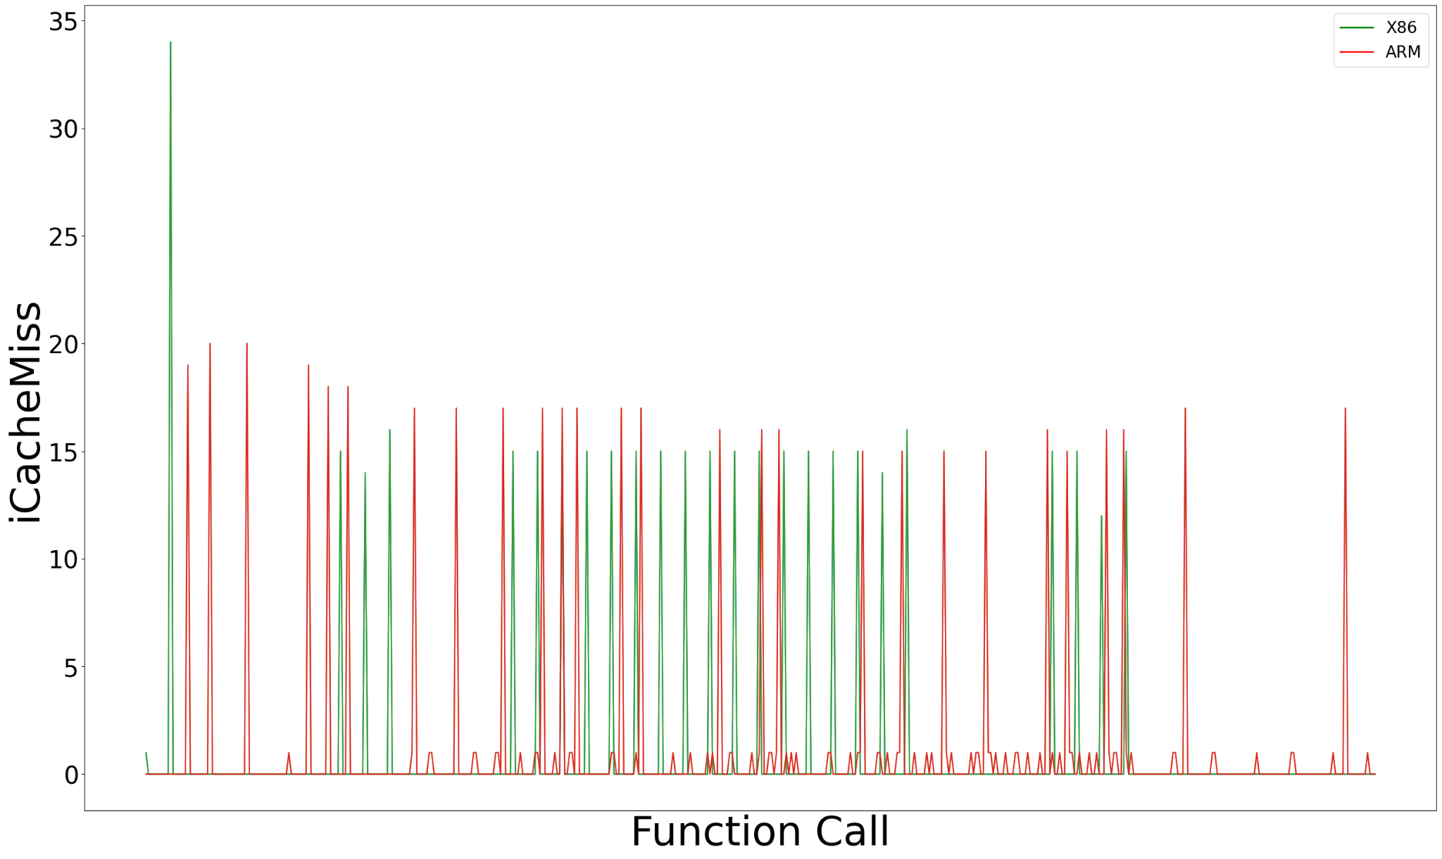
Observations – spec_rand
References:
N. Binkert et al., “The Gem5 simulator,” SIGARCH Comput. Archit. News,vol. 39, pp. 1–7, Aug. 2011.

Slide 22
Observations – spec_rand
References:
N. Binkert et al., “The Gem5 simulator,” SIGARCH Comput. Archit. News,vol. 39, pp. 1–7, Aug. 2011.

Slide 23
Observations – spec_rand
References:
N. Binkert et al., “The Gem5 simulator,” SIGARCH Comput. Archit. News,vol. 39, pp. 1–7, Aug. 2011.

Slide 24
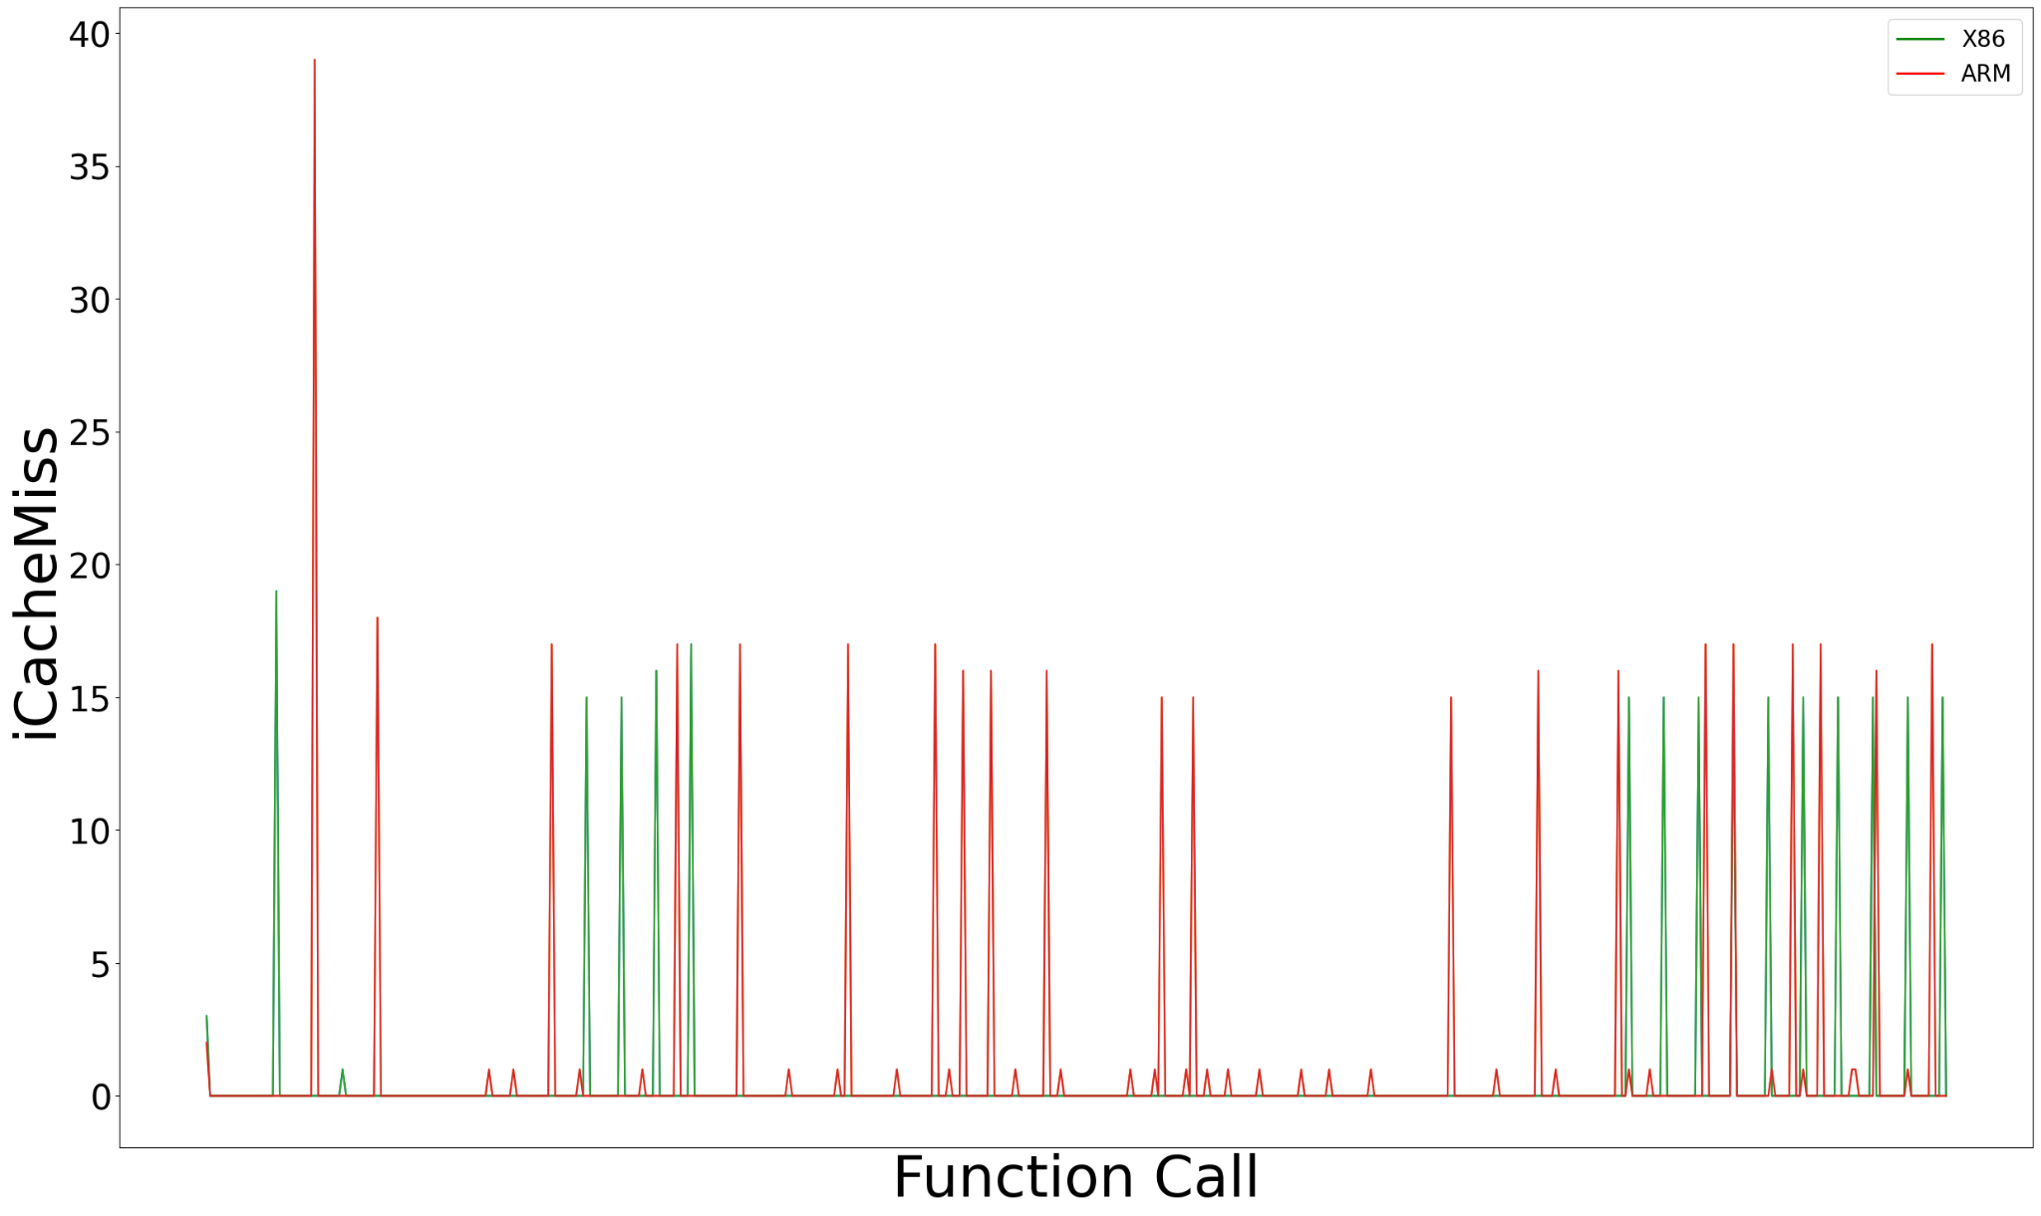
Observations – spec_genrand_int32
References:
N. Binkert et al., “The Gem5 simulator,” SIGARCH Comput. Archit. News,vol. 39, pp. 1–7, Aug. 2011.

Slide 25
Observations – spec_genrand_int32
References:
N. Binkert et al., “The Gem5 simulator,” SIGARCH Comput. Archit. News,vol. 39, pp. 1–7, Aug. 2011.

Slide 26
Observations – spec_genrand_int32
References:
N. Binkert et al., “The Gem5 simulator,” SIGARCH Comput. Archit. News,vol. 39, pp. 1–7, Aug. 2011.

Slide 27
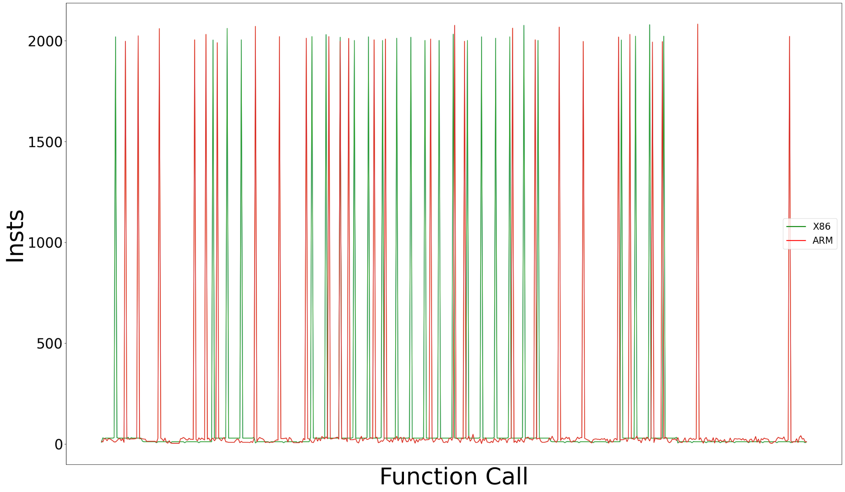
Observations – spec_rand
References:
N. Binkert et al., “The Gem5 simulator,” SIGARCH Comput. Archit. News,vol. 39, pp. 1–7, Aug. 2011.

Slide 28
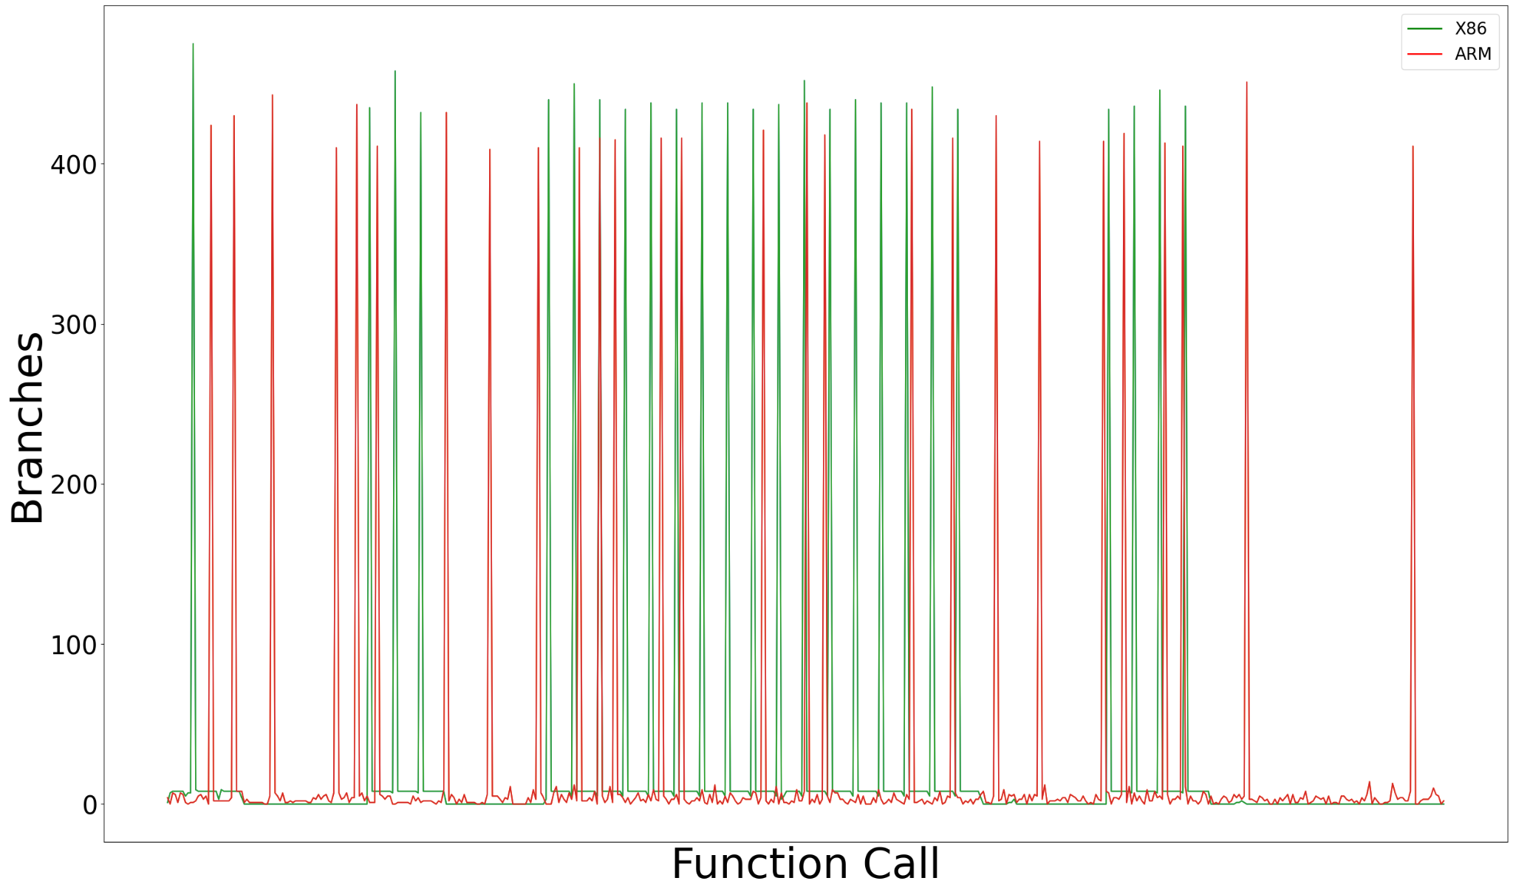
Observations – spec_rand
References:
N. Binkert et al., “The Gem5 simulator,” SIGARCH Comput. Archit. News,vol. 39, pp. 1–7, Aug. 2011.

Slide 29
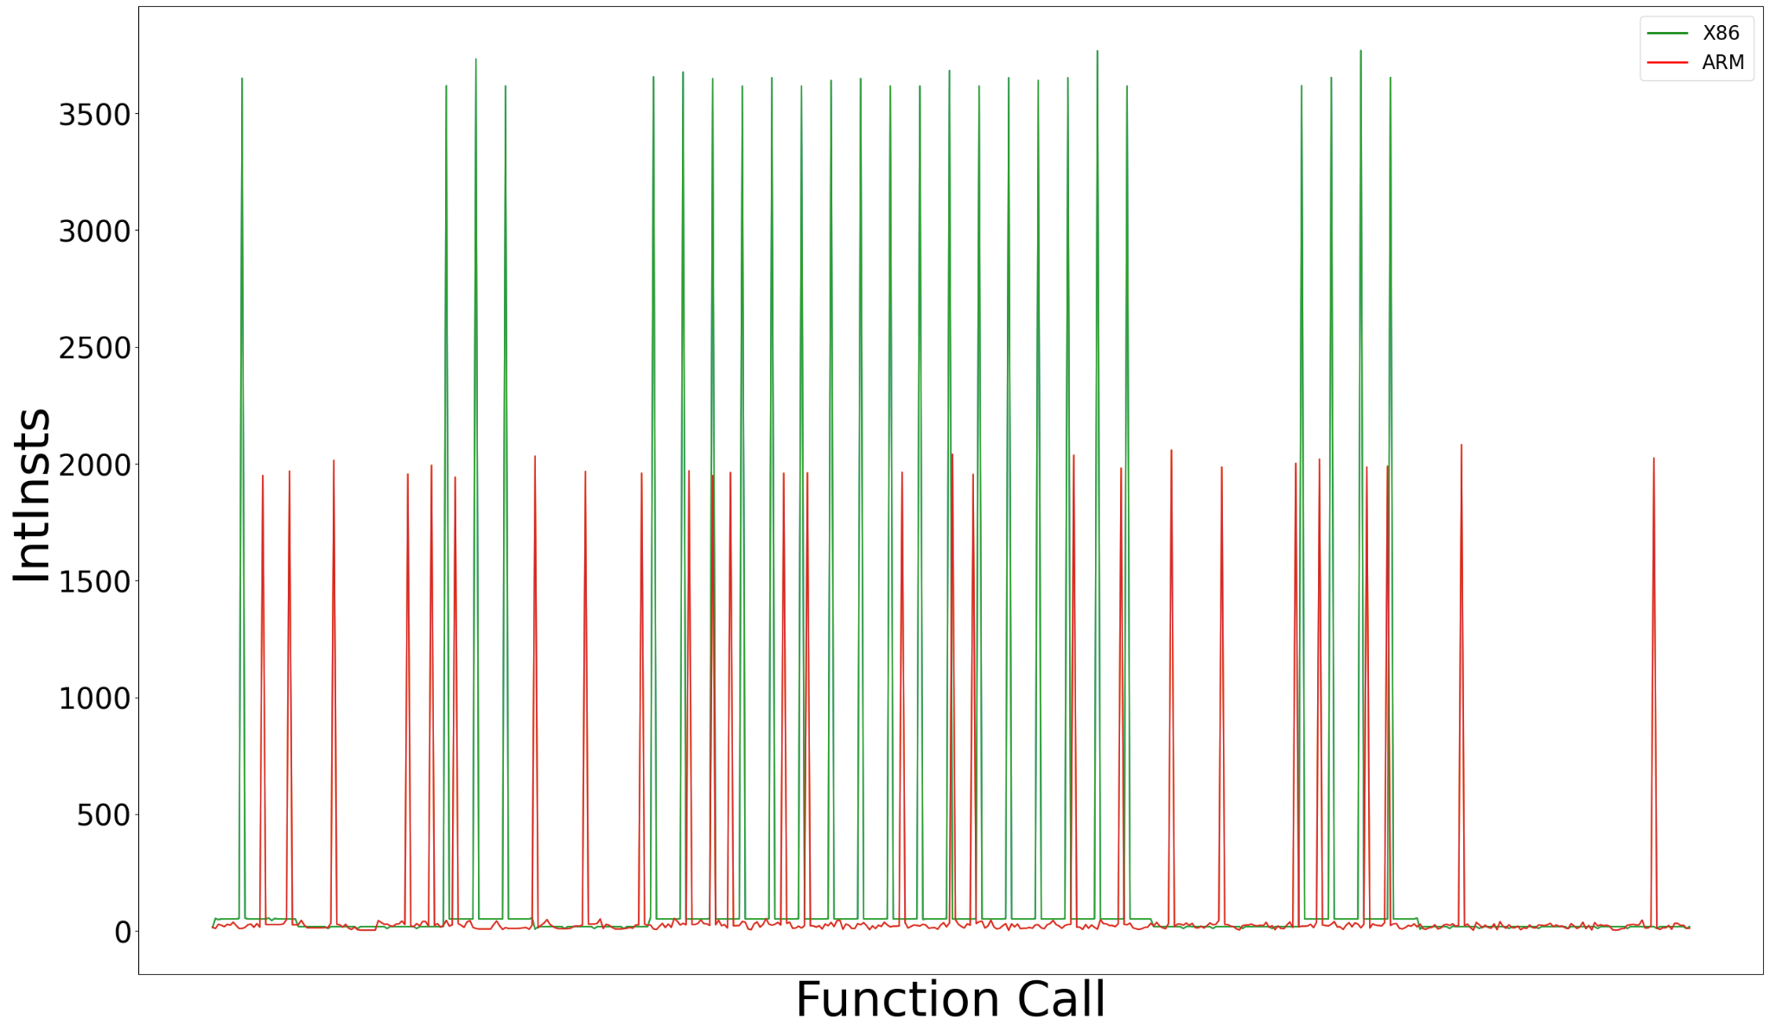
Observations – spec_rand
References:
N. Binkert et al., “The Gem5 simulator,” SIGARCH Comput. Archit. News,vol. 39, pp. 1–7, Aug. 2011.

Slide 30
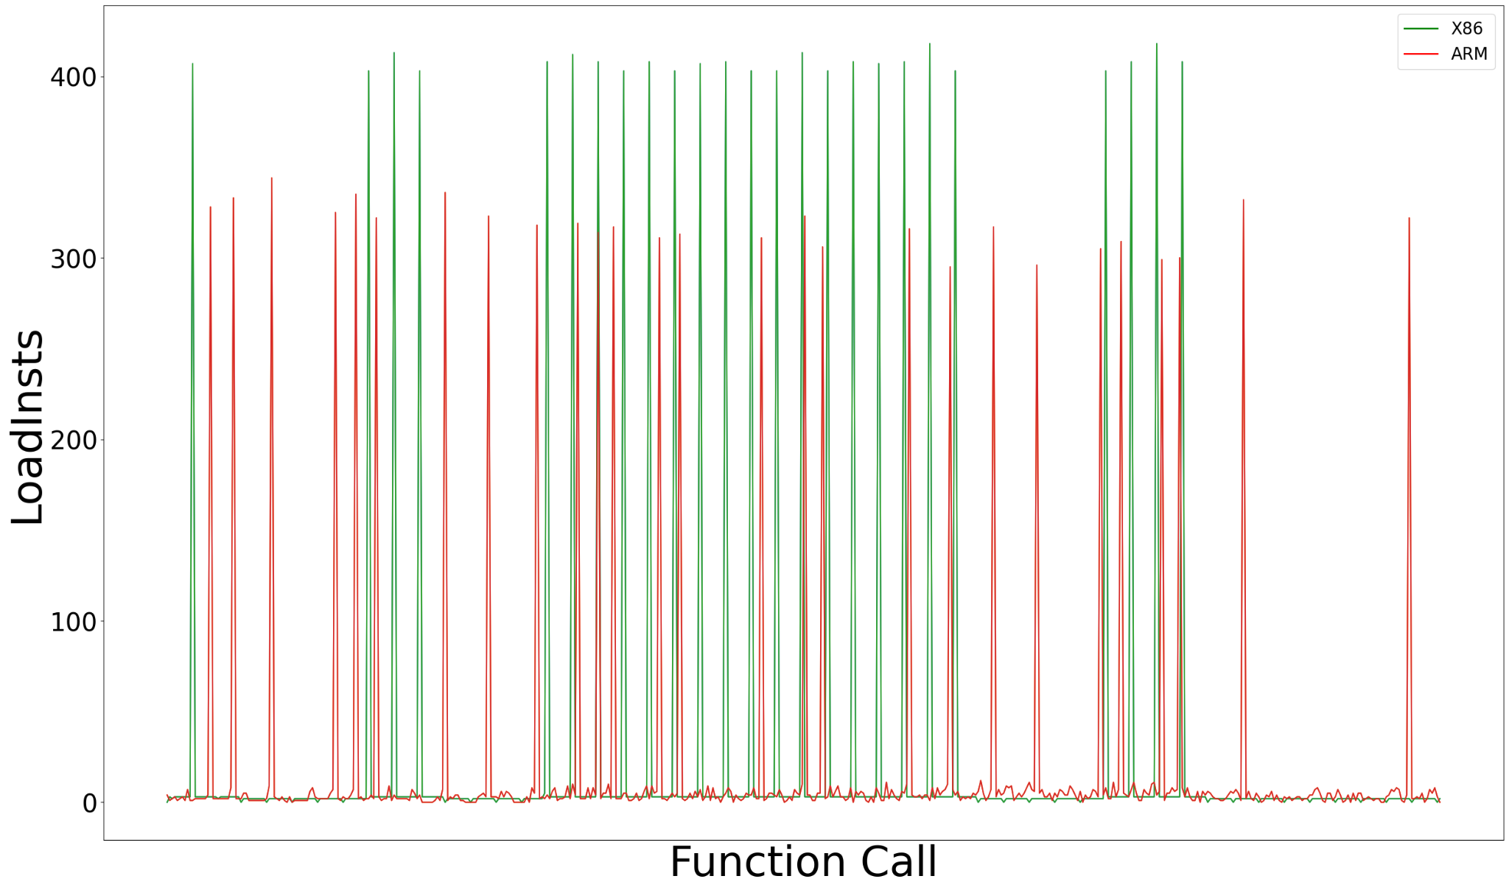
Observations – spec_rand
References:
N. Binkert et al., “The Gem5 simulator,” SIGARCH Comput. Archit. News,vol. 39, pp. 1–7, Aug. 2011.

Slide 31
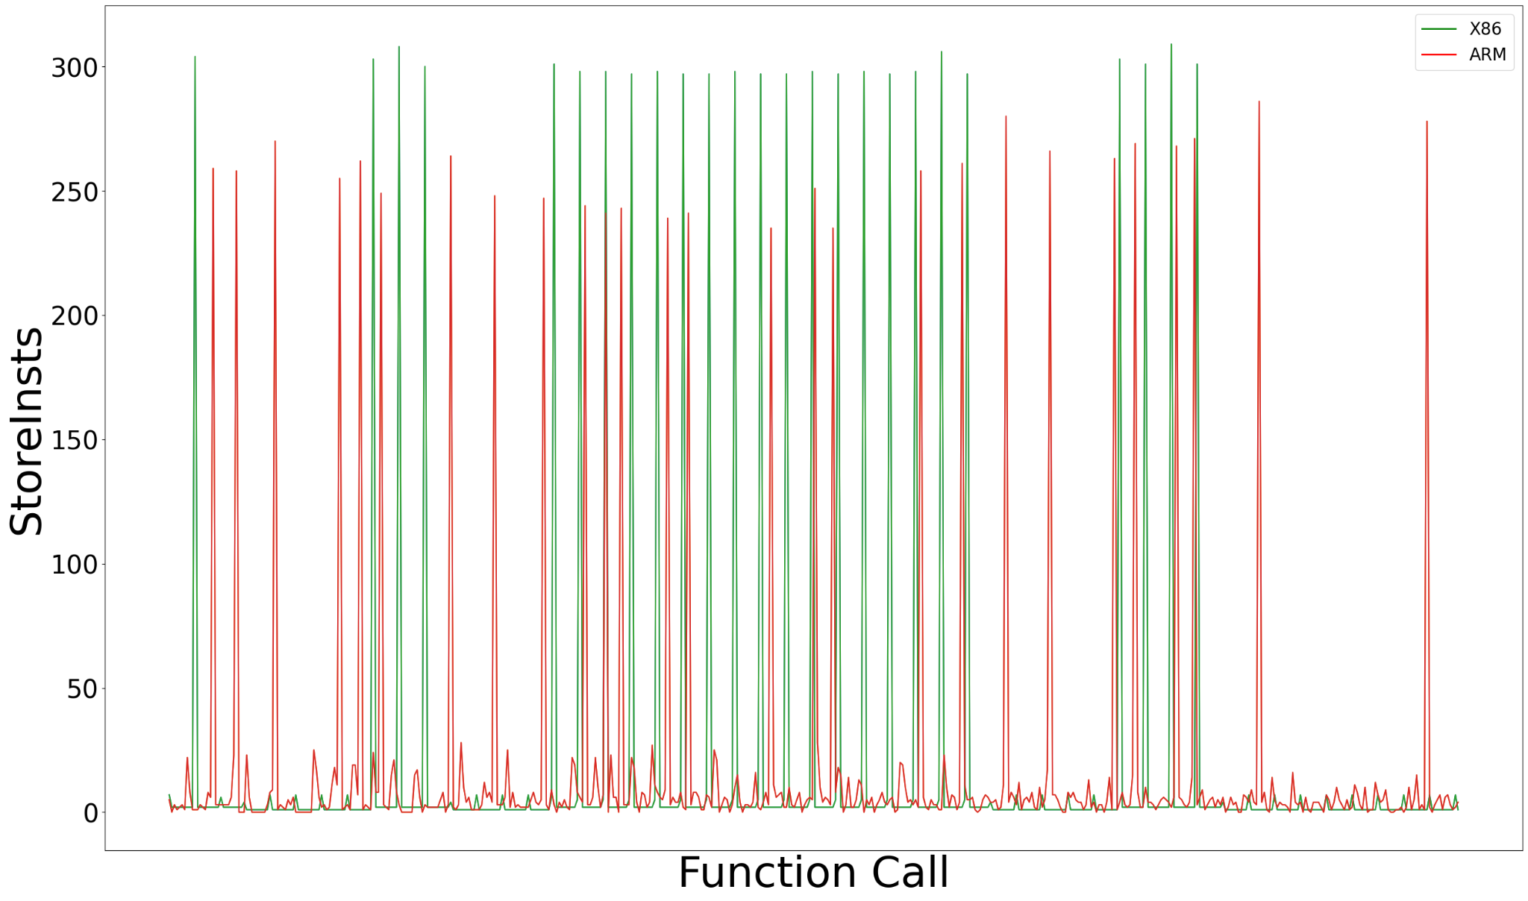
Observations – spec_rand
References:
N. Binkert et al., “The Gem5 simulator,” SIGARCH Comput. Archit. News,vol. 39, pp. 1–7, Aug. 2011.

Slide 32
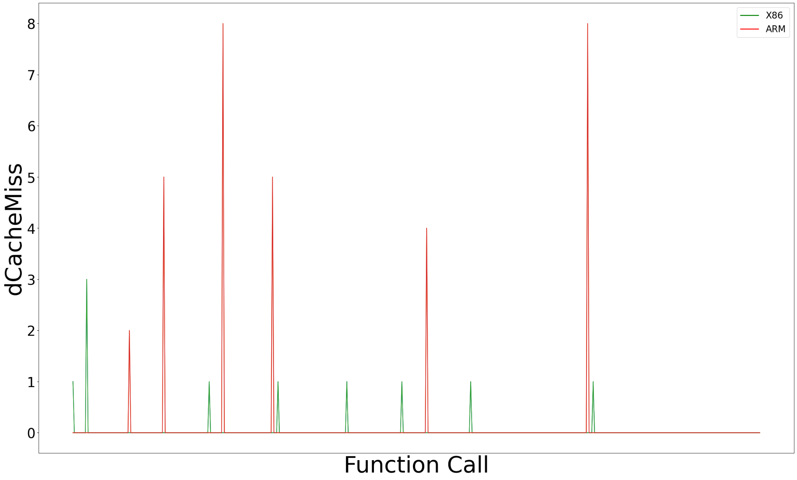
Observations – spec_rand
References:
N. Binkert et al., “The Gem5 simulator,” SIGARCH Comput. Archit. News,vol. 39, pp. 1–7, Aug. 2011.

Slide 33
Observations – spec_rand
References:
N. Binkert et al., “The Gem5 simulator,” SIGARCH Comput. Archit. News,vol. 39, pp. 1–7, Aug. 2011.

Slide 34
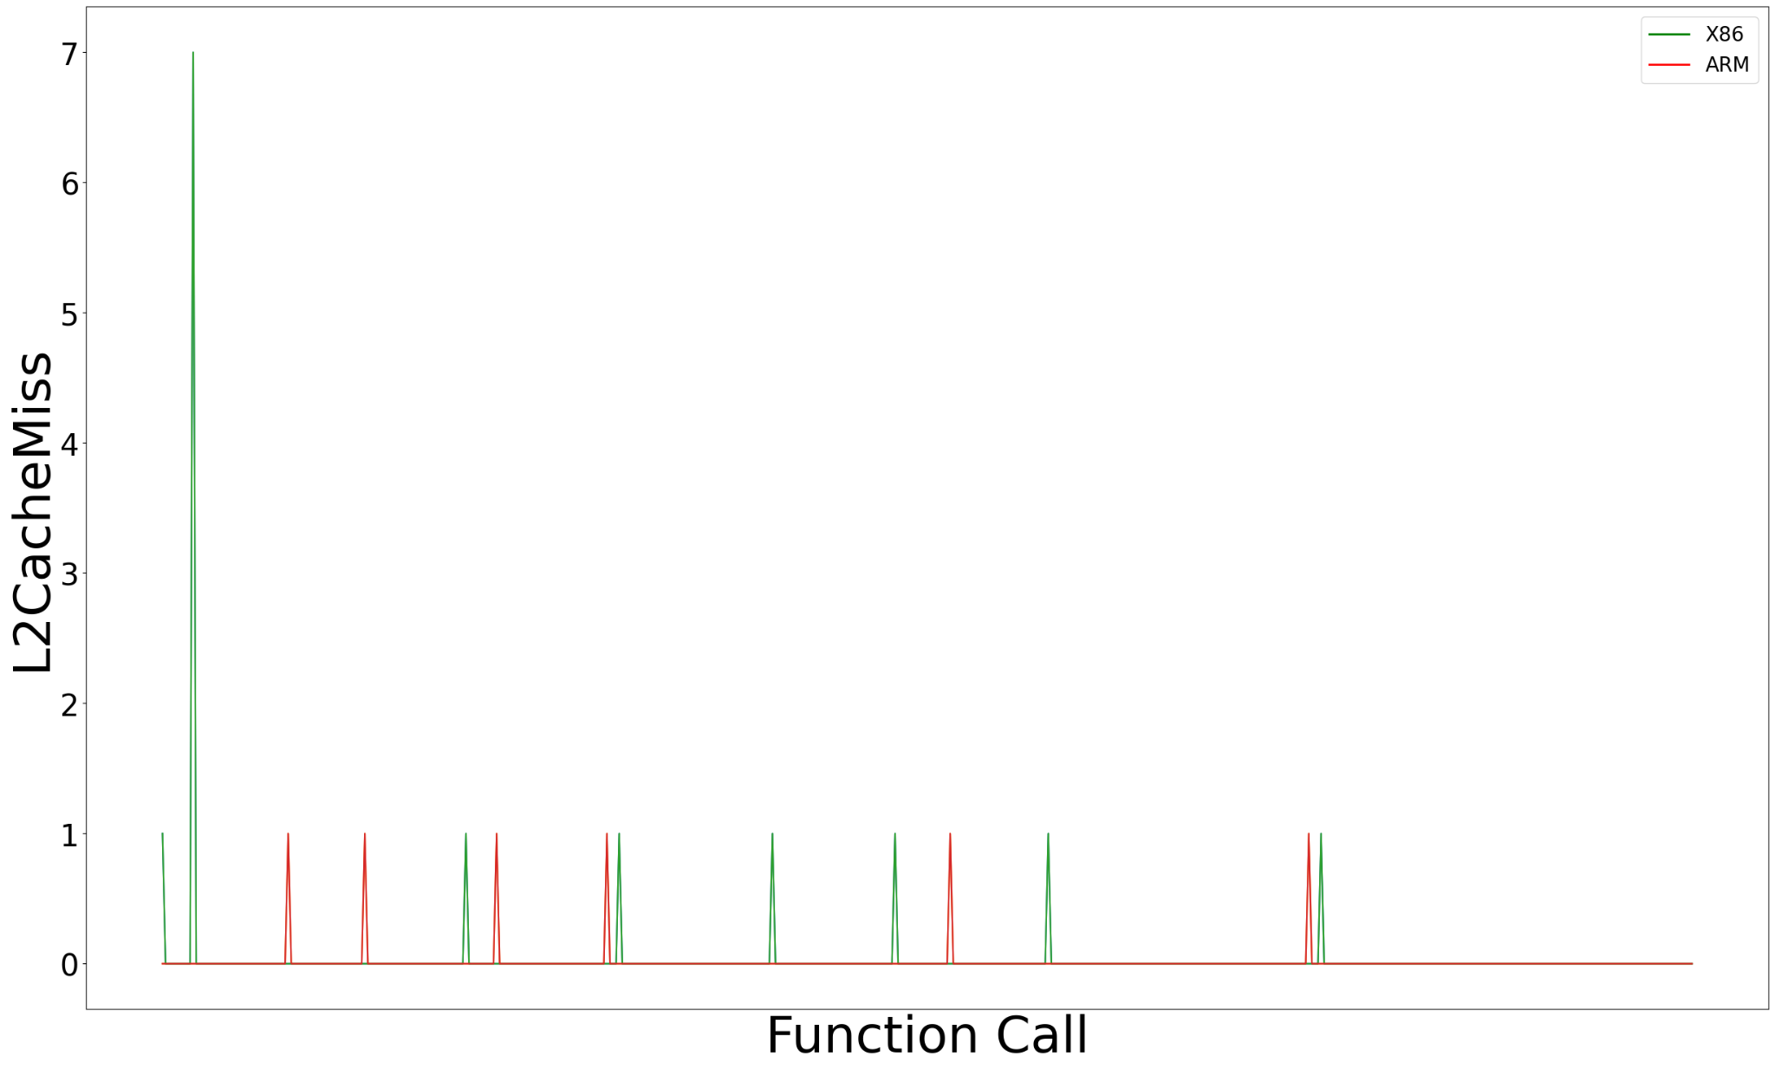
Observations – spec_rand
References:
N. Binkert et al., “The Gem5 simulator,” SIGARCH Comput. Archit. News,vol. 39, pp. 1–7, Aug. 2011.

Slide 35
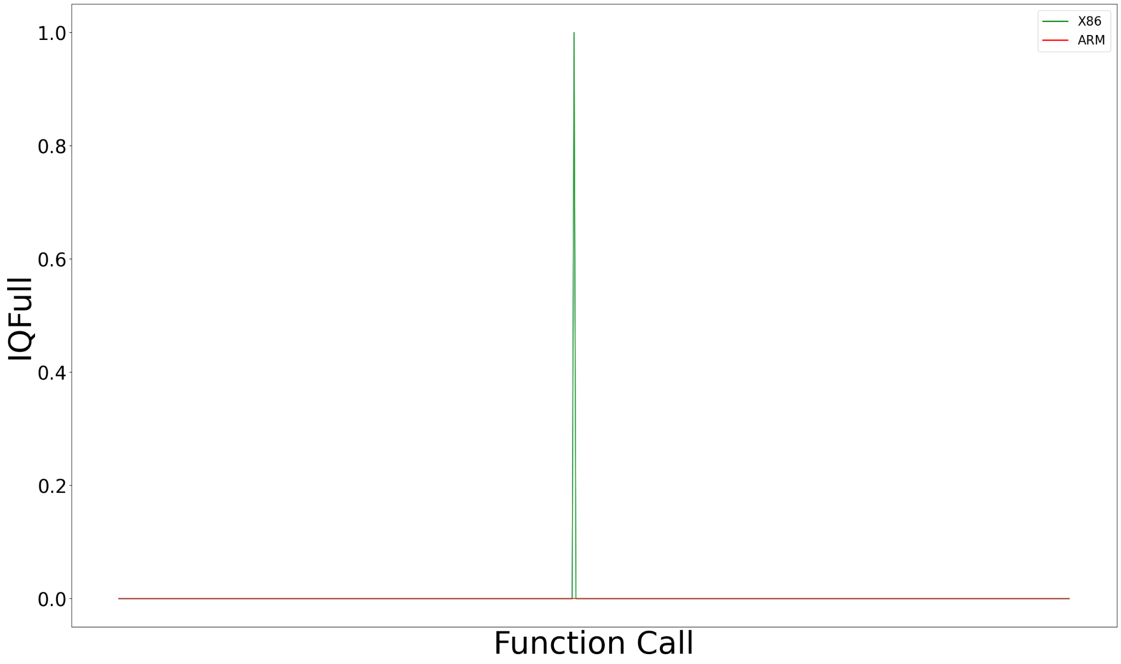
Observations – spec_rand
References:
N. Binkert et al., “The Gem5 simulator,” SIGARCH Comput. Archit. News,vol. 39, pp. 1–7, Aug. 2011.

Slide 36
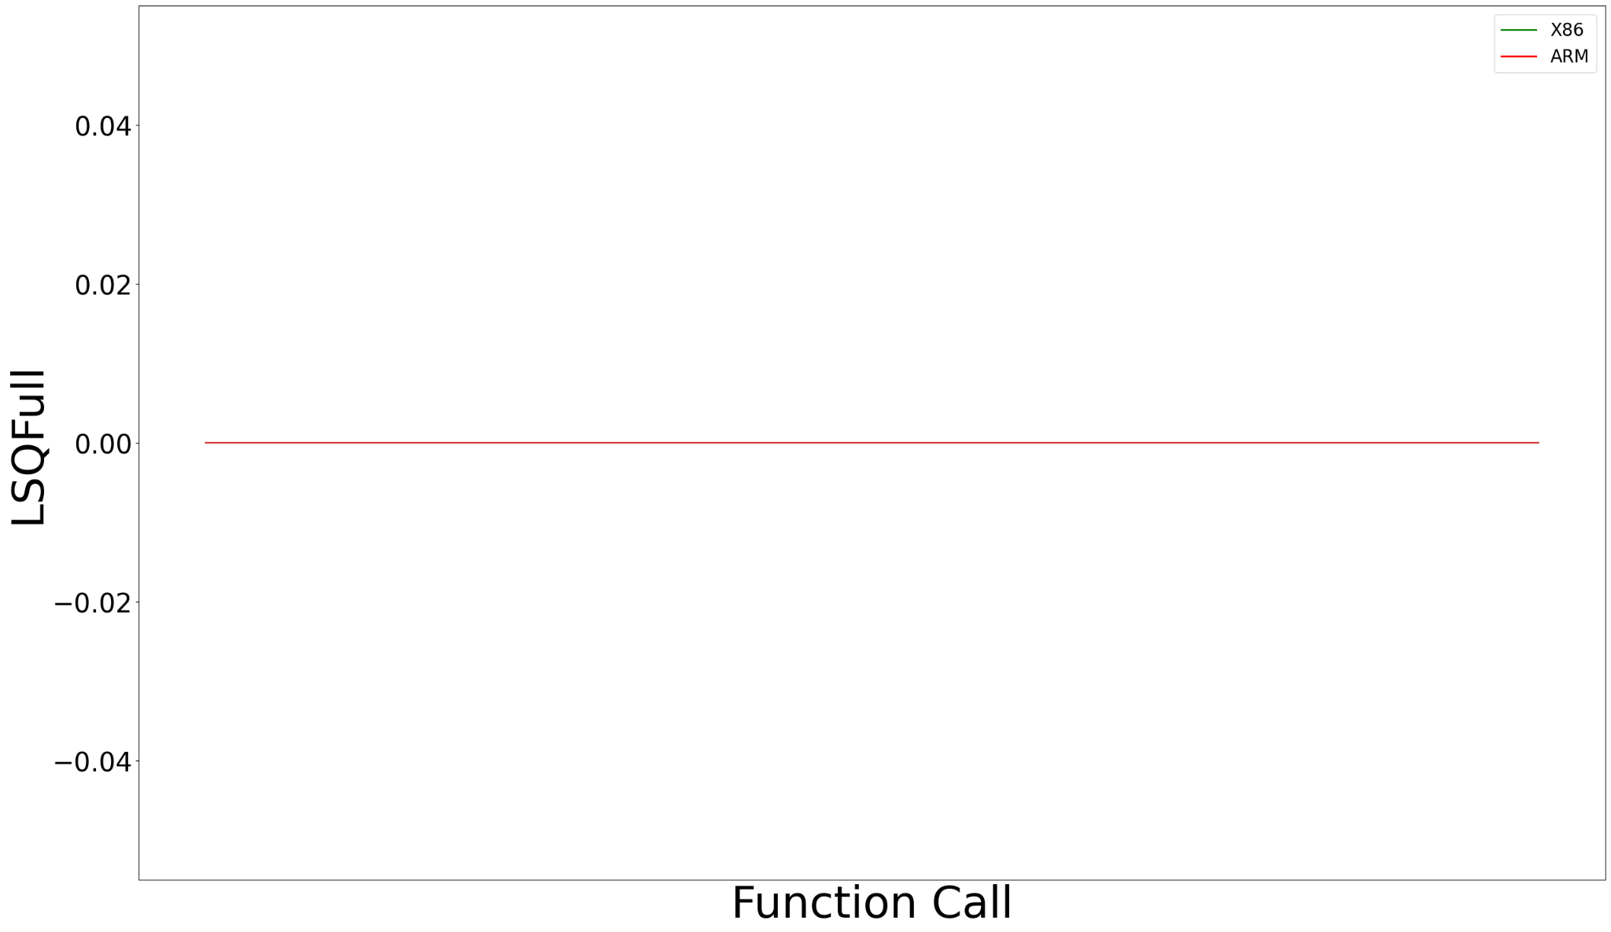
Observations – spec_rand
References:
N. Binkert et al., “The Gem5 simulator,” SIGARCH Comput. Archit. News,vol. 39, pp. 1–7, Aug. 2011.

Slide 37
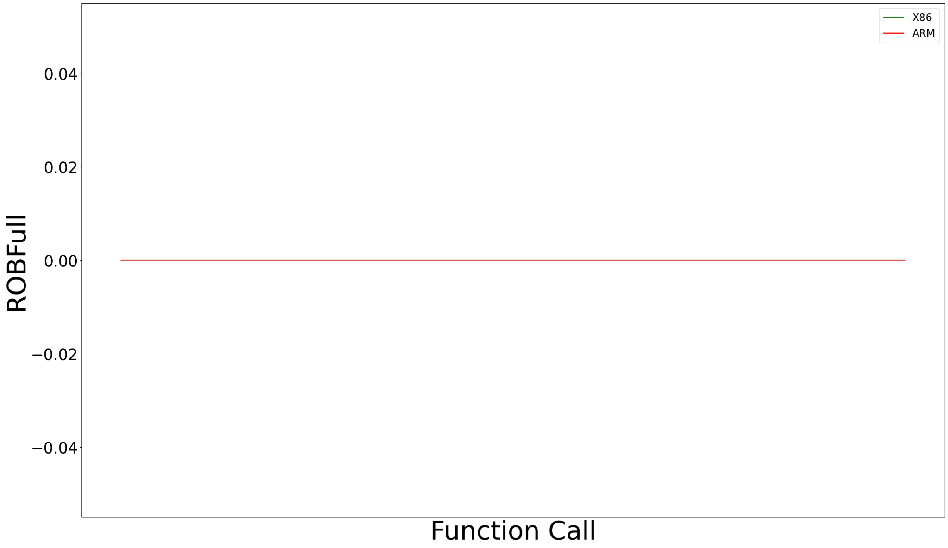
Observations – spec_rand
References:
N. Binkert et al., “The Gem5 simulator,” SIGARCH Comput. Archit. News,vol. 39, pp. 1–7, Aug. 2011.

Slide 38
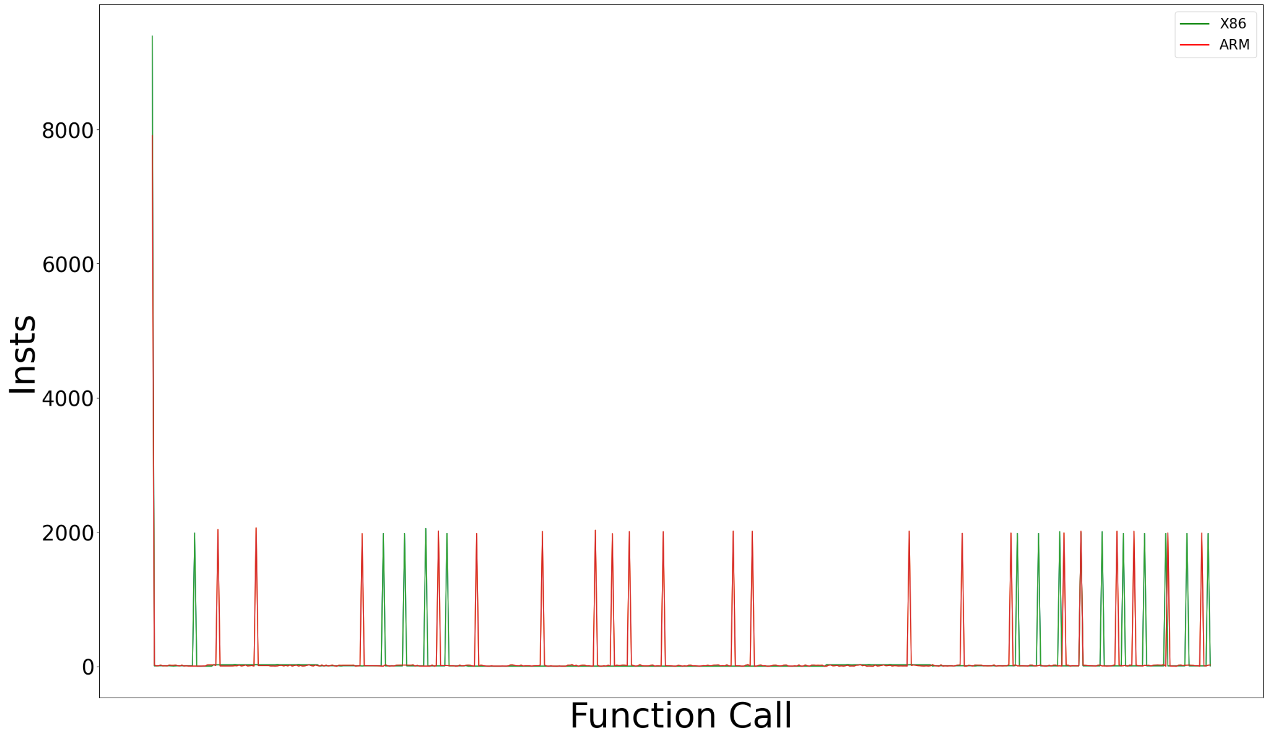
Observations – spec_genrand_int32
References:
N. Binkert et al., “The Gem5 simulator,” SIGARCH Comput. Archit. News,vol. 39, pp. 1–7, Aug. 2011.

Slide 39
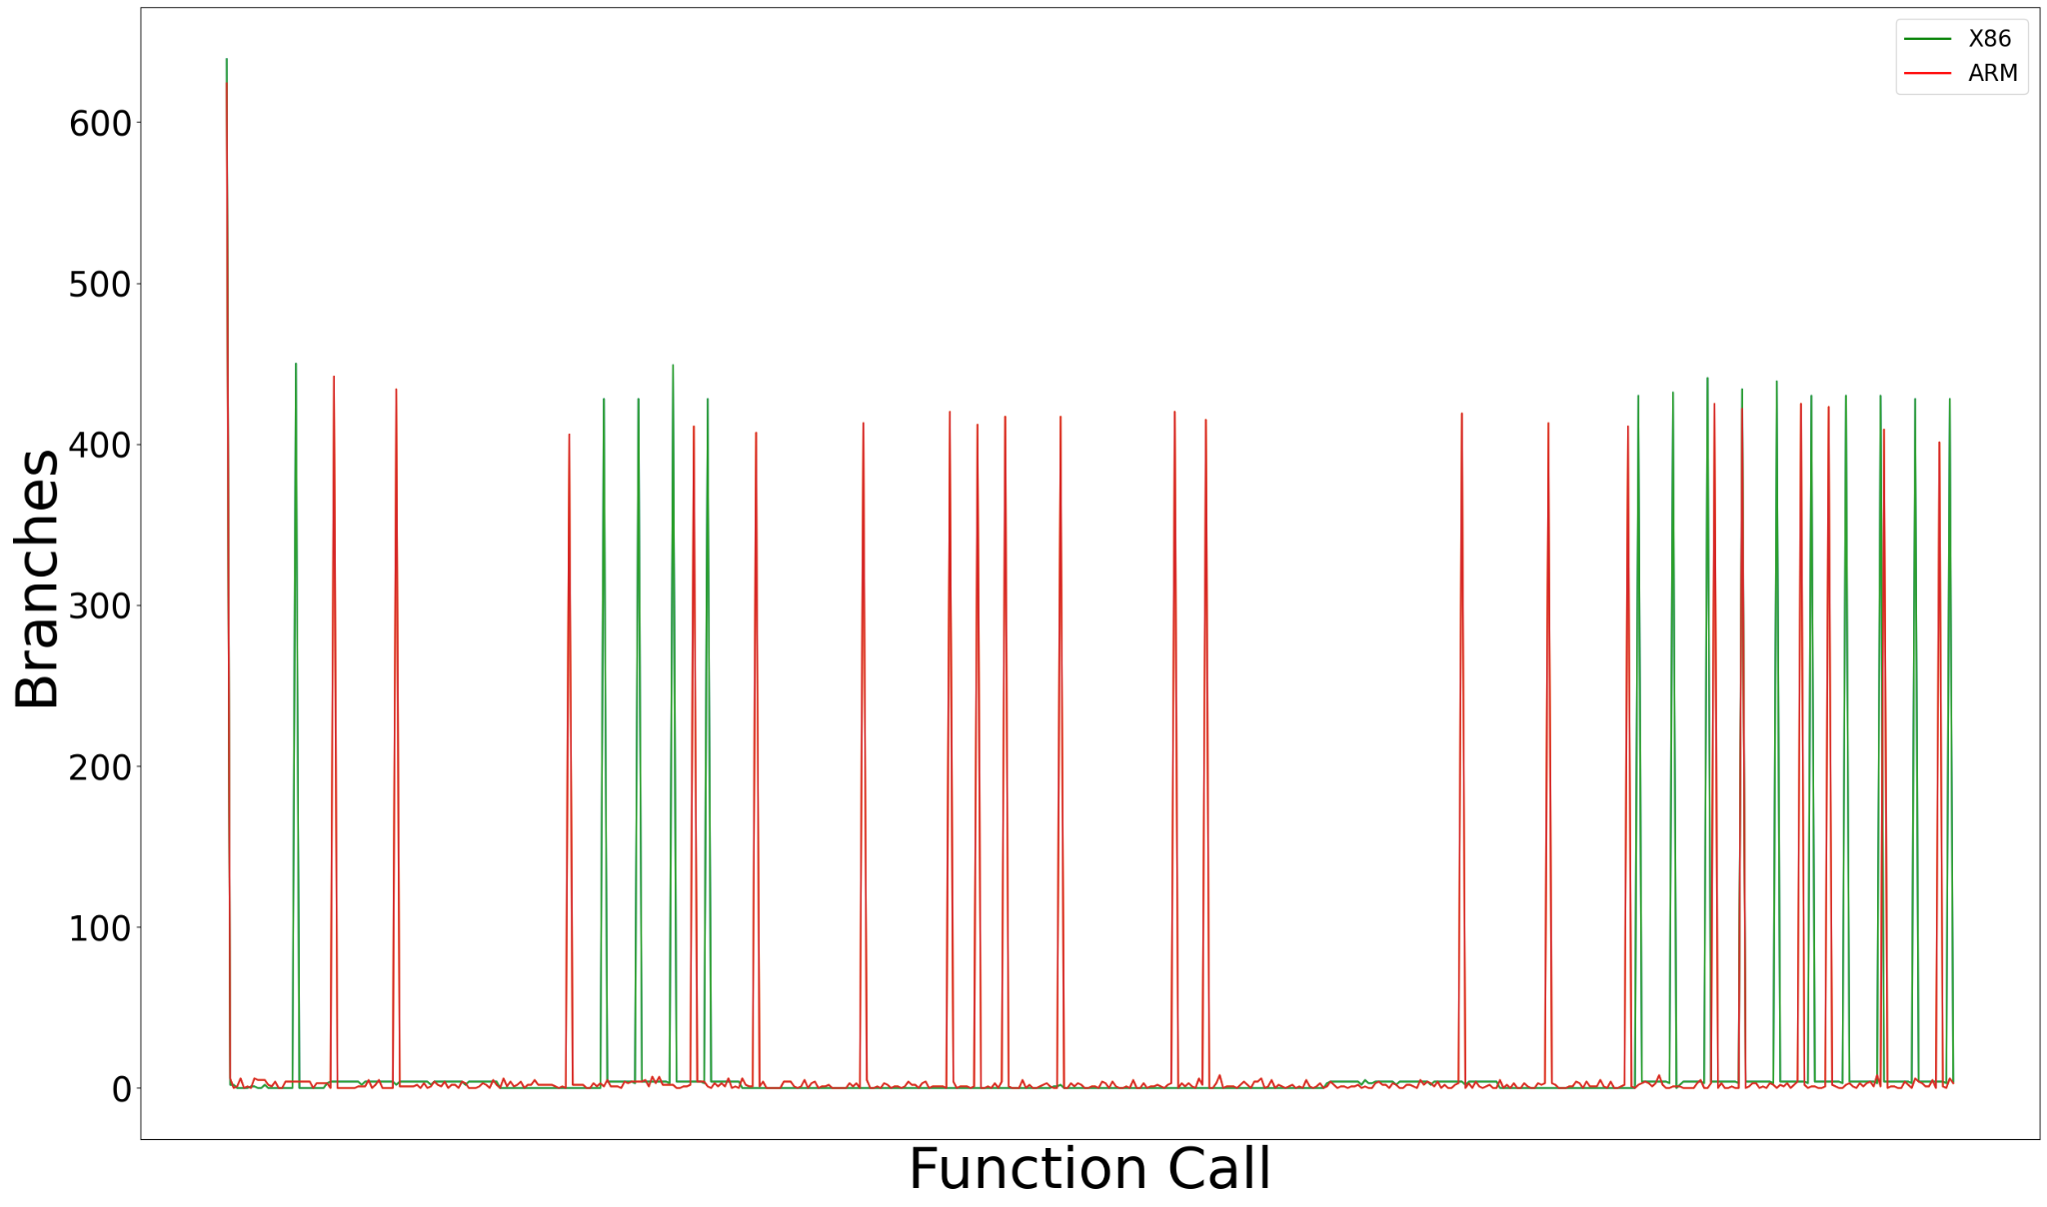
Observations – spec_genrand_int32
References:
N. Binkert et al., “The Gem5 simulator,” SIGARCH Comput. Archit. News,vol. 39, pp. 1–7, Aug. 2011.

Slide 40
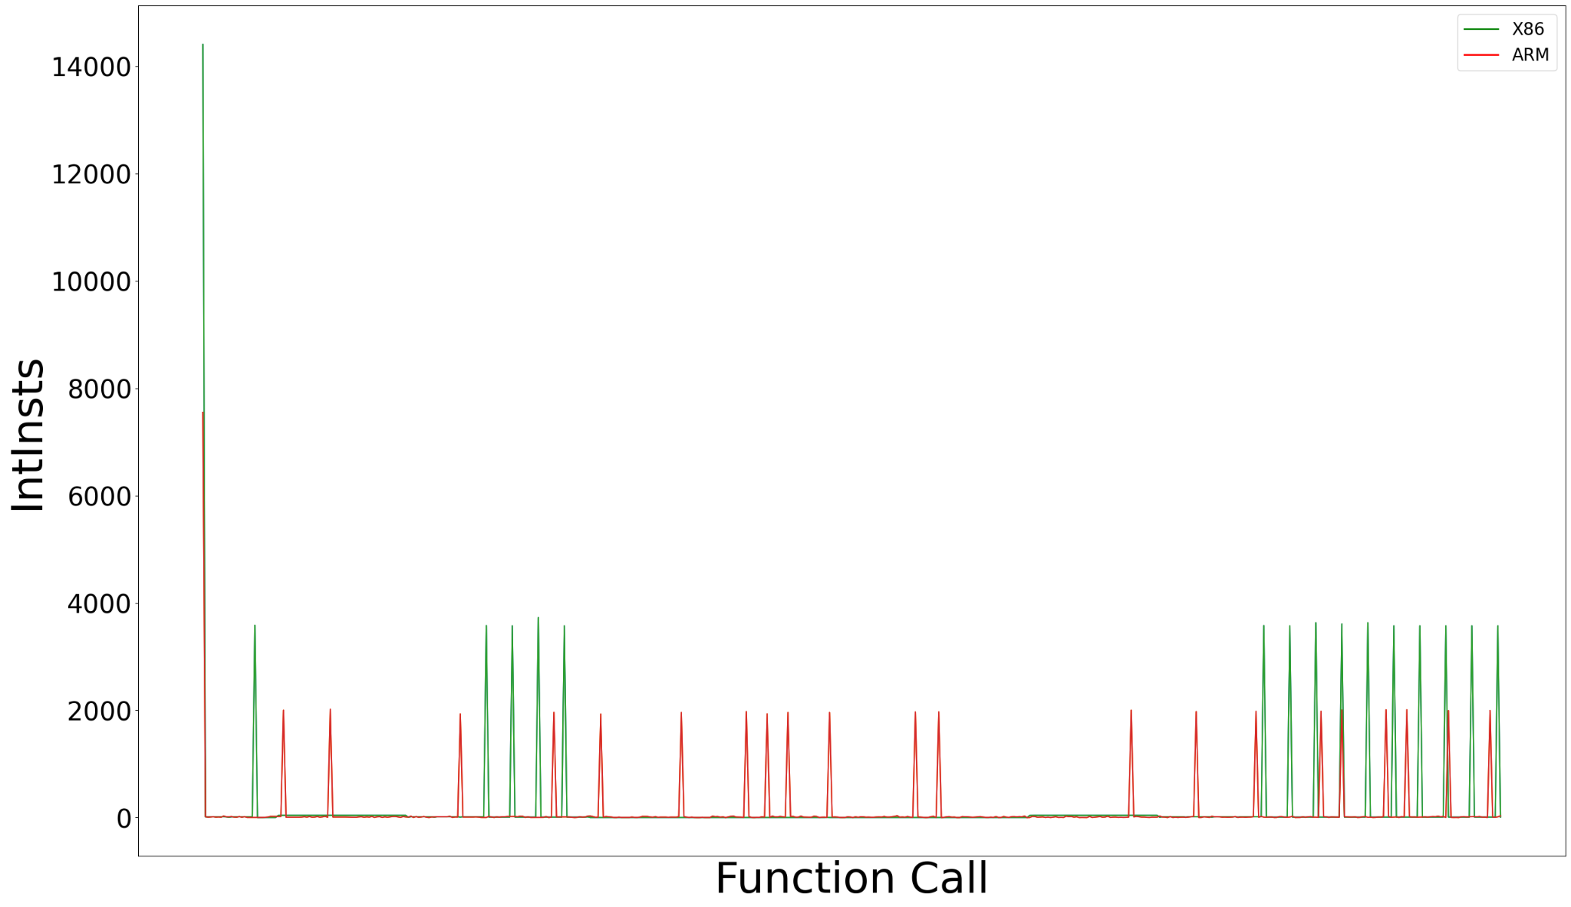
Observations – spec_genrand_int32
References:
N. Binkert et al., “The Gem5 simulator,” SIGARCH Comput. Archit. News,vol. 39, pp. 1–7, Aug. 2011.

Slide 41
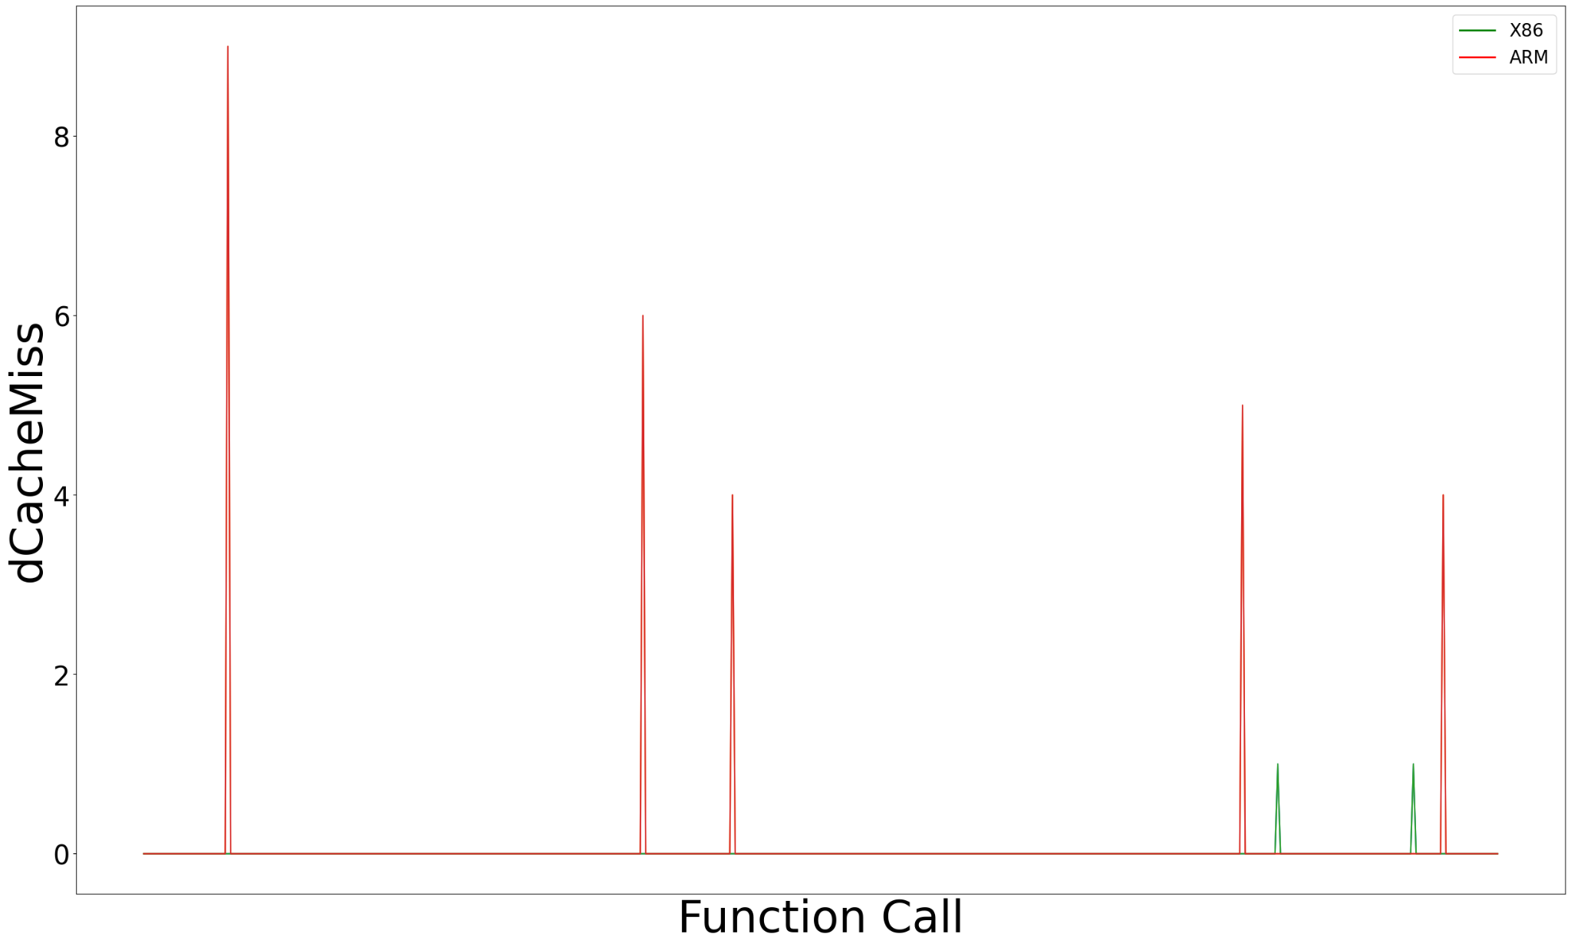
Observations – spec_genrand_int32
Observations – spec_genrand_int32
References:
N. Binkert et al., “The Gem5 simulator,” SIGARCH Comput. Archit. News,vol. 39, pp. 1–7, Aug. 2011.

Slide 42
Observations – spec_genrand_int32
References:
N. Binkert et al., “The Gem5 simulator,” SIGARCH Comput. Archit. News,vol. 39, pp. 1–7, Aug. 2011.

Slide 43
05 : Conclusion

Slide 44
Conclusion
We have observed that Branch Mispredictions and Instruction Cache Misses are important parameters, directly affecting the the performance
We will continue exploration of other parameters using feature engineering and dimensionality reduction to find the optimal parameters
Further, we will use the list of optimal parameters to design a different schedulers with minimal hardware overhead for performance and energy improvements

Slide 45
References
Boran, N.K., Rathore, S., Udeshi, M. and Singh, V., 2020. Fine-Grained Scheduling in Heterogeneous-ISA Architectures. IEEE Computer Architecture Letters, 20(1), pp.9-12.
Venkat, A. and Tullsen, D.M., 2014. Harnessing ISA diversity: Design of a heterogeneous-ISA chip multiprocessor. ACM SIGARCH Computer Architecture News, 42(3), pp.121-132.
DeVuyst, M., Venkat, A. and Tullsen, D.M., 2012, March. Execution migration in a heterogeneous-ISA chip multiprocessor. In Proceedings of the seventeenth international conference on Architectural Support for Programming Languages and Operating Systems (pp. 261-272).
Boran, N.K., Yadav, D.K. and Iyer, R., 2019. Performance modelling and dynamic scheduling on heterogeneous-ISA multi-core architectures. In VLSI Design and Test: 23rd International Symposium, VDAT 2019, Indore, India, July 4–6, 2019, Revised Selected Papers 23 (pp. 702-715). Springer Singapore.

Slide 46
References
5. Lukefahr, A., Padmanabha, S., Das, R., Sleiman, F.M., Dreslinski, R., Wenisch, T.F. and Mahlke, S., 2012, December. Composite cores: Pushing heterogeneity into a core. In 2012 45th annual IEEE/ACM international symposium on microarchitecture (pp. 317-328). IEEE.
6. R. Kumar, K. I. Farkas, N. P. Jouppi, P. Ranganathan, and D. M. Tullsen. Single-ISA Heterogeneous Multi-core Architectures: The Potential for Processor Power Reduction. In International Symposium on Microarchitecture, Dec. 2003.
7. Kumar, R., Tullsen, D.M., Jouppi, N.P. and Ranganathan, P., 2005. Heterogeneous chip multiprocessors. Computer, 38(11), pp.32-38.
8. N. Binkert et al., “The Gem5 simulator,” SIGARCH Comput. Archit. News, vol. 39, pp. 1–7, Aug. 2011.

Slide 47
Thank you!
Do you have any questions regarding the presentation?

